Slide 1
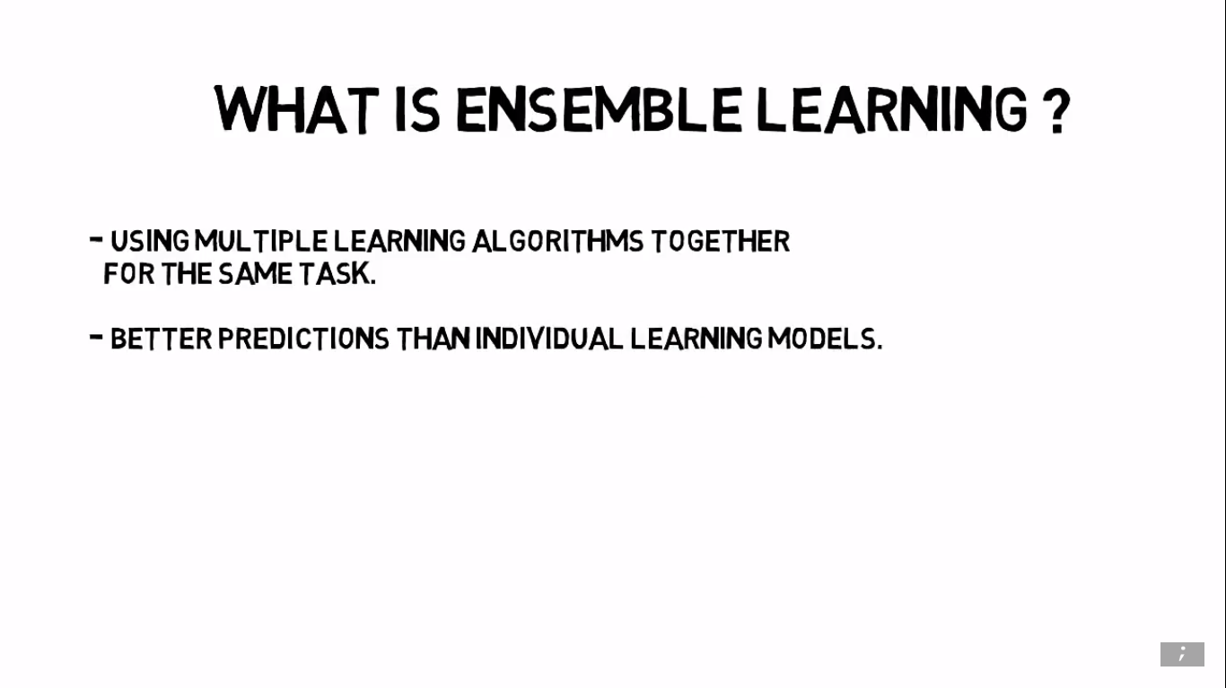

Slide 2
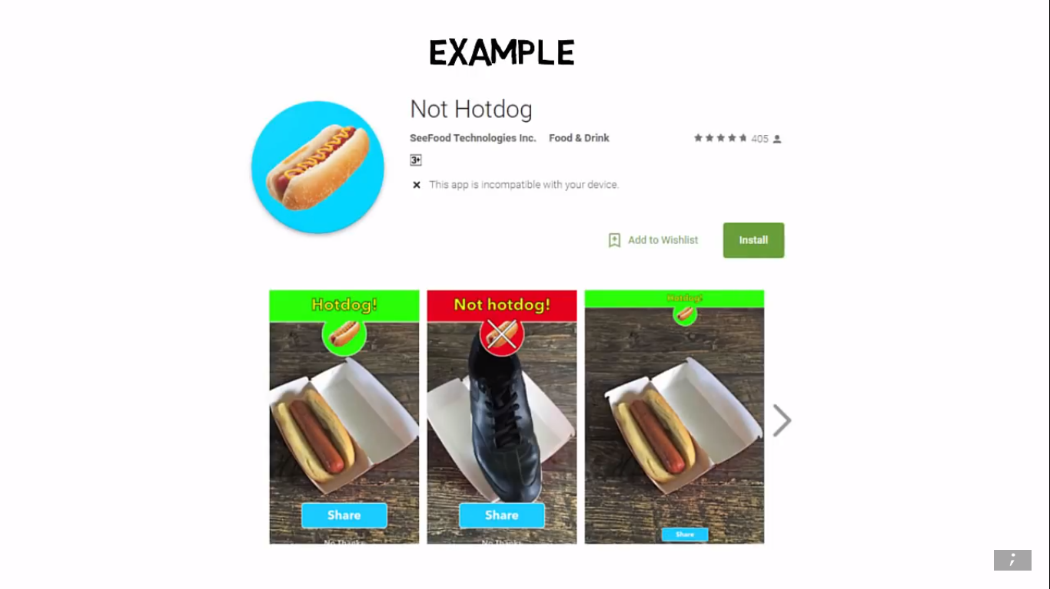

Slide 3
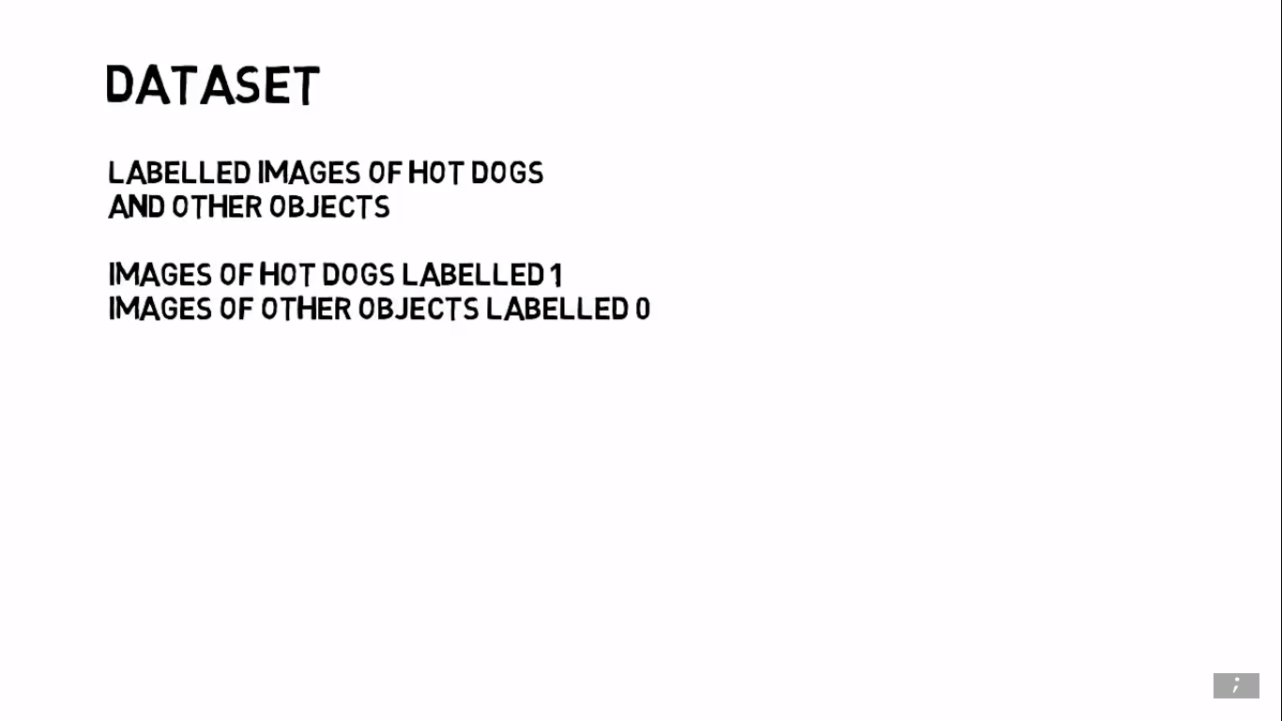

Slide 4
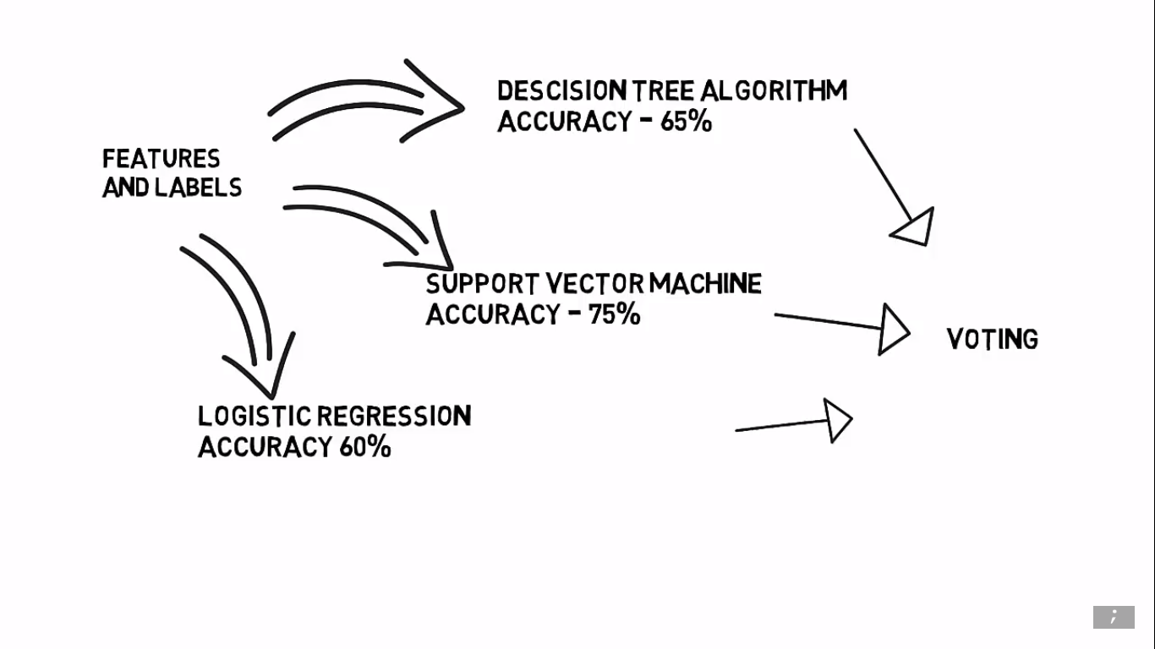

Slide 5
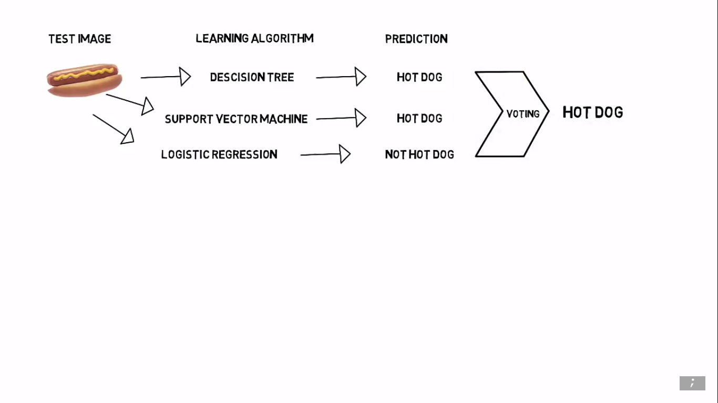

Slide 6
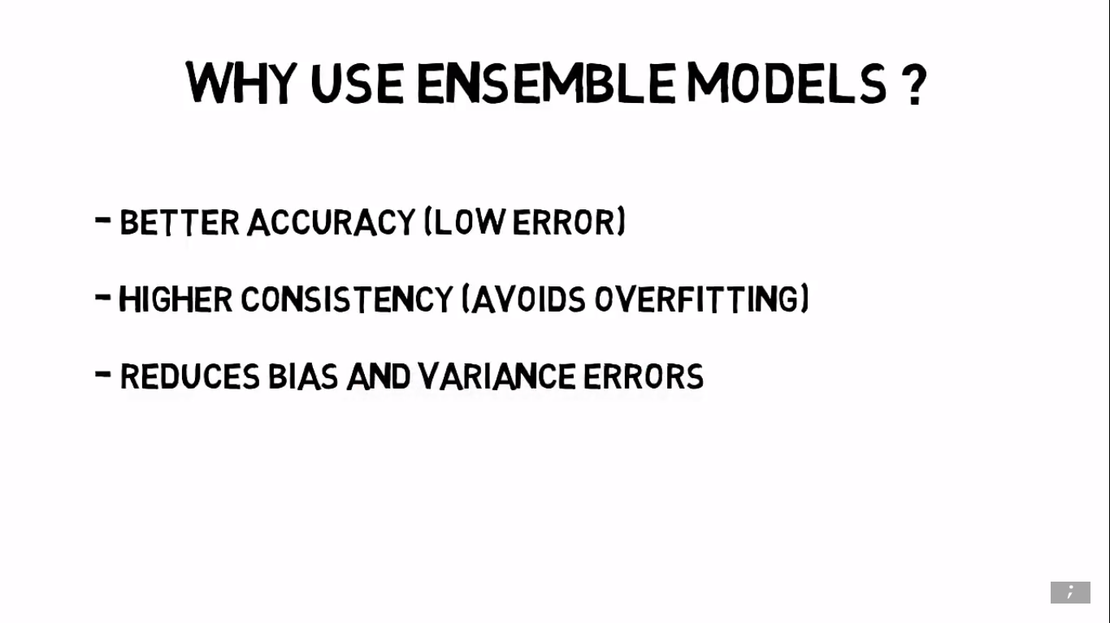

Slide 7
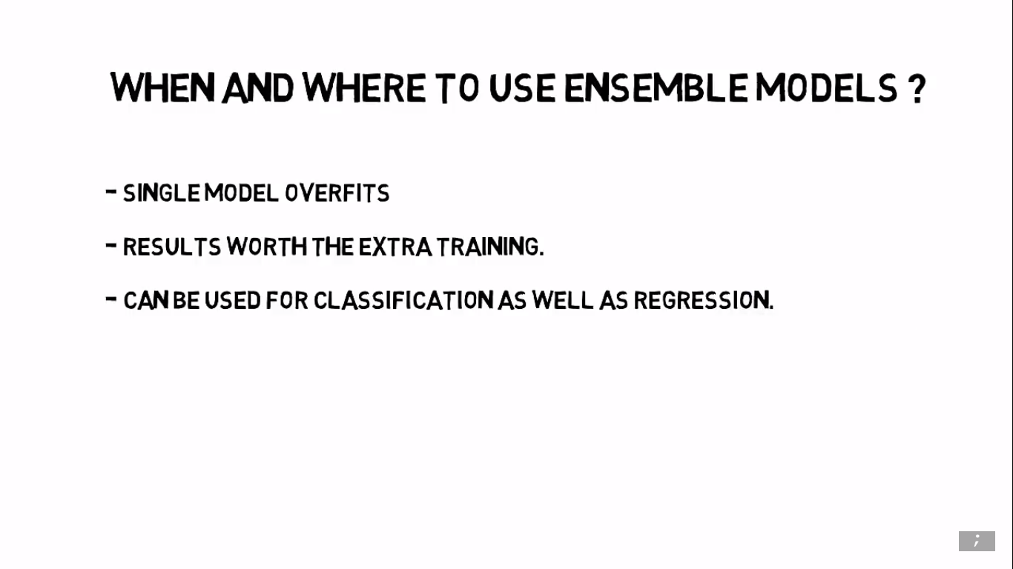

Slide 8
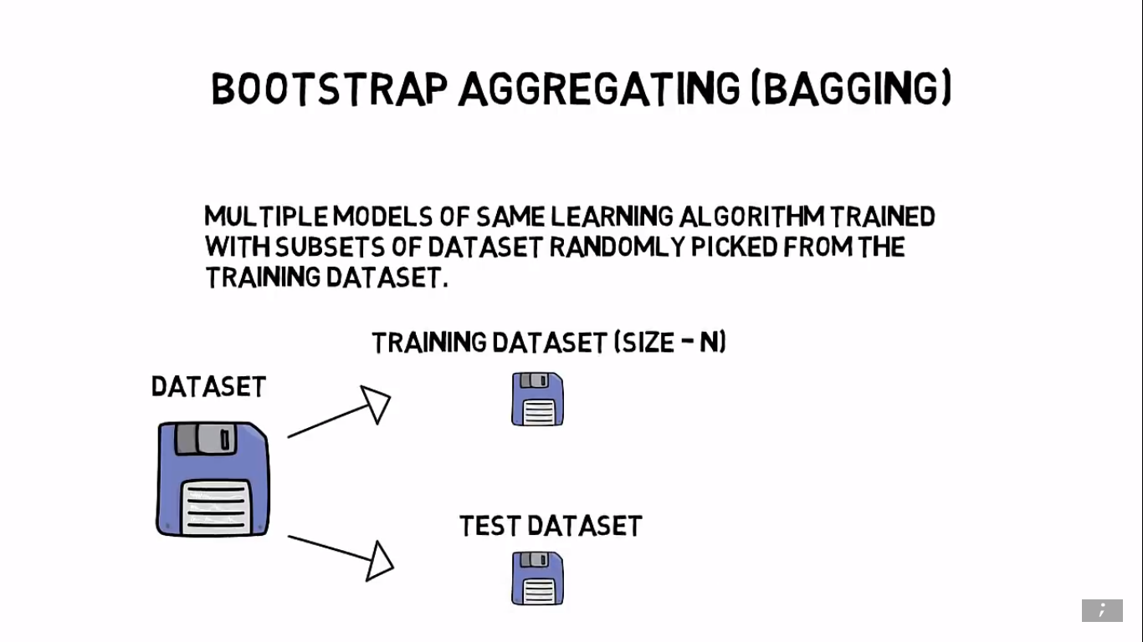

Slide 9
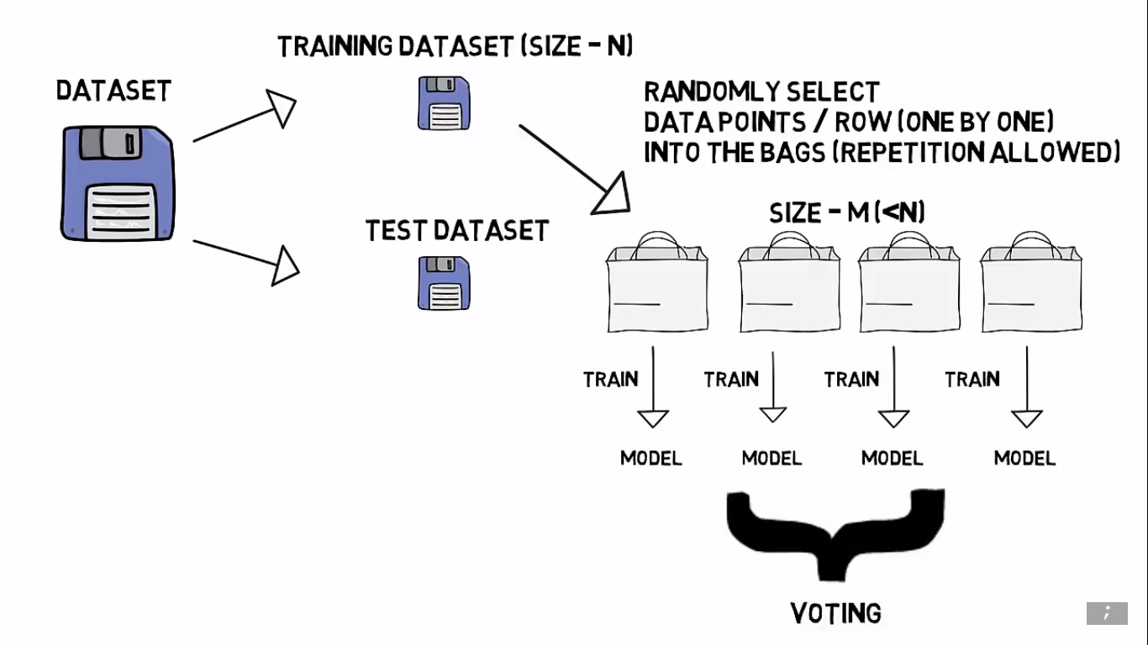

Slide 10
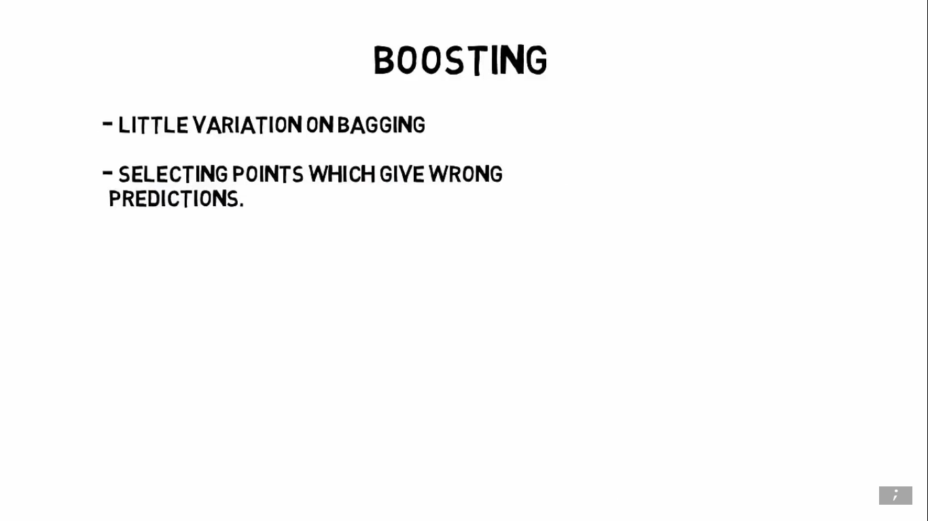

Slide 11
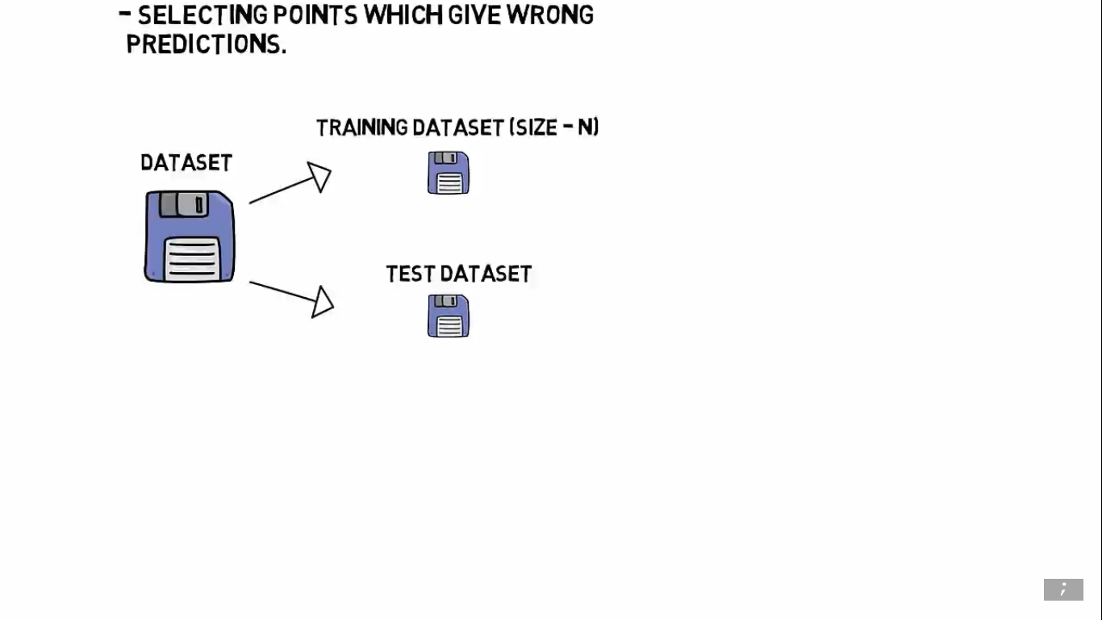

Slide 12
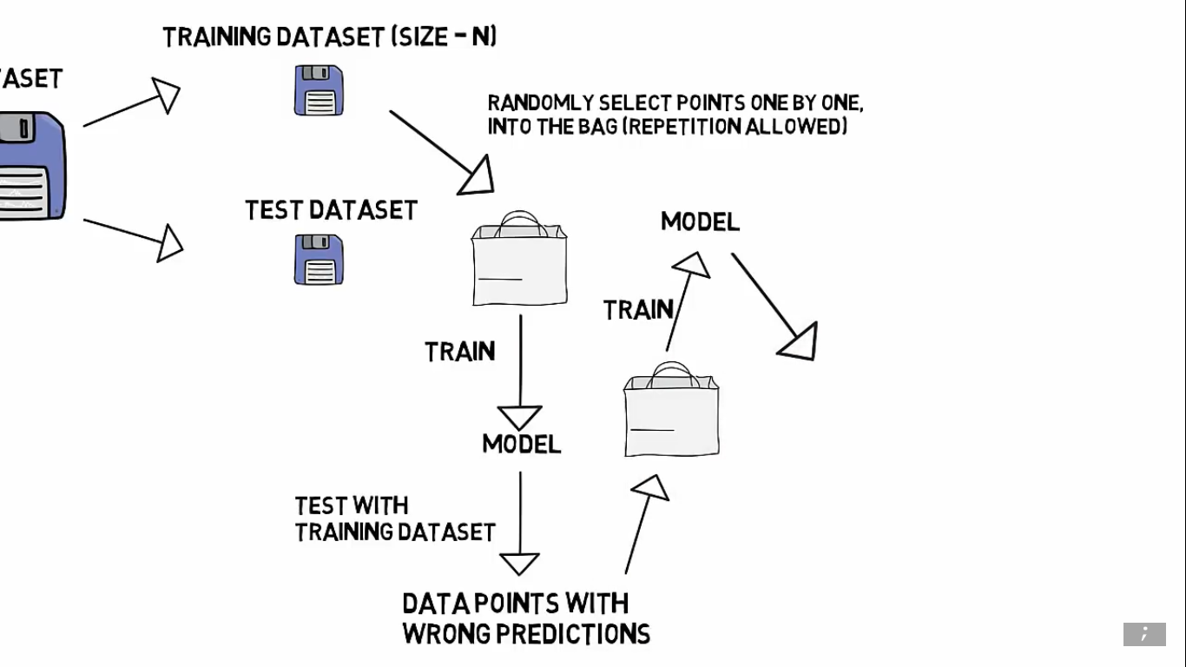

Slide 13
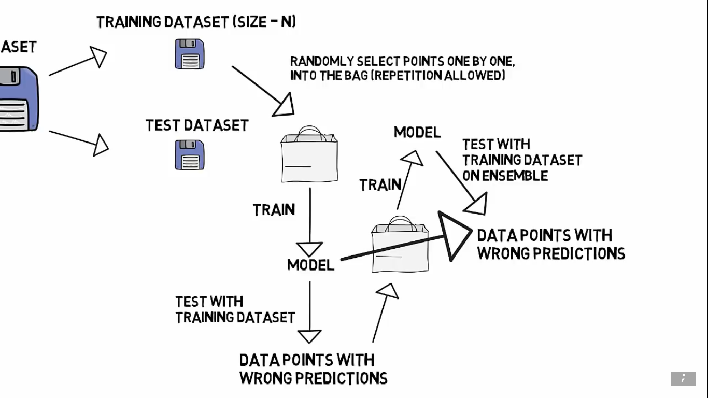

Slide 14
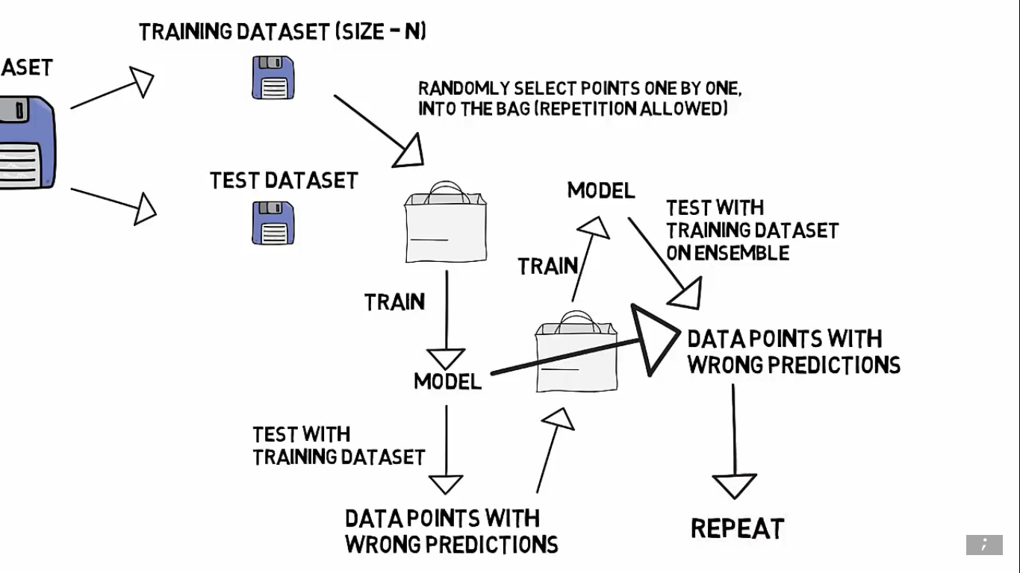

Slide 15
Popular Ensemble Models
Bagging
Bagging Tree Classifier
Random Forest
Boosting
Adaptive Boosting
Gradient Boosted Trees
Xgboost

Slide 16
Random Forest
Bootstrap dataset is used
Considers no. of features at a node randomly
No. of random features considered at each node = sqrt(N)
Trees are grown to full length until the stopping criterion is reached
All the trees are independent of each other
Test data set is passed through all the trees.
Final prediction is taken as the majority vote of all the tress in case of classification and in case of regression final value is the average of all the values

Slide 17
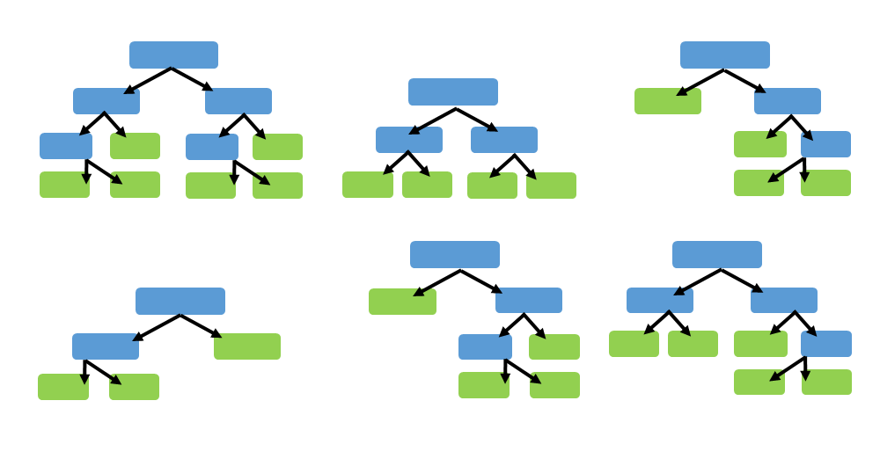

Slide 18
Adaptive boosting
A subset of the total data points are used in training
Only one feature the most important feature is considered at the node
We have stumps instead of trees. Meaning just a single node.
Trees are dependent on the test performance of the previous tree.
Miss-classified samples in T1 are weighed heavily in T2 thus encouraging the
Unlike Random Forest each trees here have their say according to how well they have performed.
Meaning if T1 has a greater accuracy than T2 then it’s vote share will be more

Slide 19
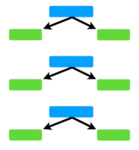

Slide 20
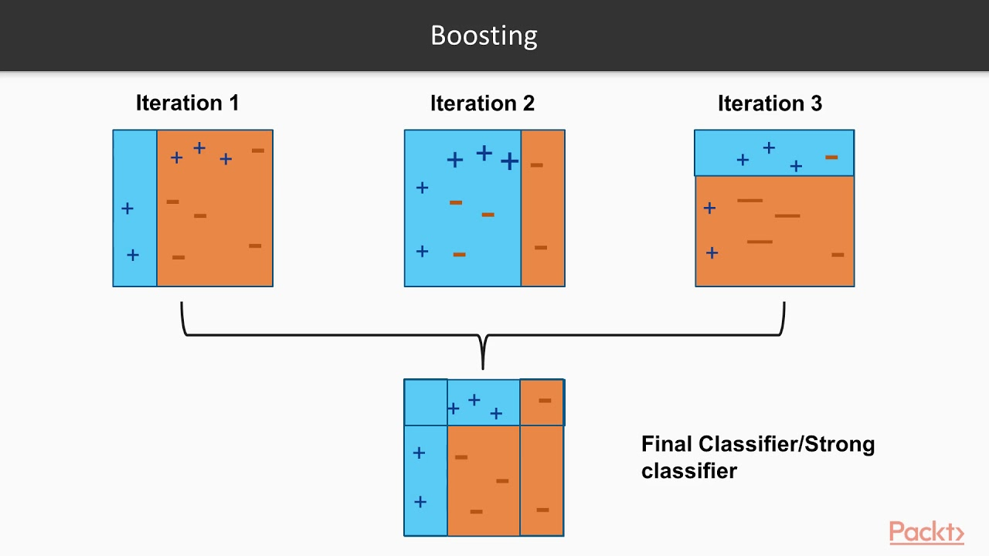

Slide 21
Gradient Boosted Trees
A subset of the total data points are used in training.
Considers all features at the root node
Trees are grown to full length.
Tress are dependent on each other.
We try to minimize the loss/cost or errors in T1 by introducing th concept of learning rate and then build another Tree T2.
Optimizing process is similar to what we saw in Linear Regression using gradient descent method.
We keep making tress until and unless we cannot improve the process further

Slide 22
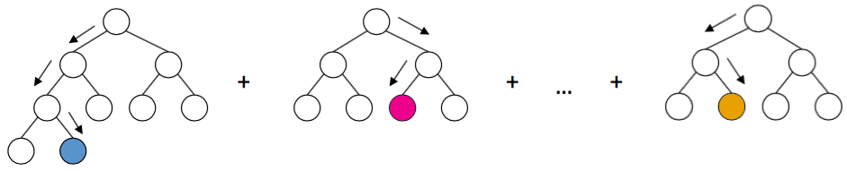

Slide 23
Explore this Project
https://medium.com/@banikanusheela/flight-departure-delay-prediction-417240a72ea4

